Slide 1
Illustrations Teaching Script for Fair Use in Art Making

Slide 2
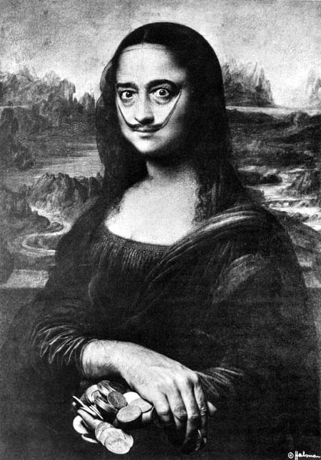
Marcel Duchamp Salvador Dali L.H.O.O.Q. or La Joconde, 1964 Self Portrait as Mona Lisa, 1954 (replica of 1919 original)

Slide 3
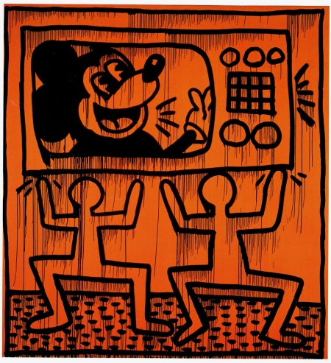
Keith Haring
Untitled, 1982

Slide 4
Andrea Blanch, Silk Gucci Sandals, 2000 (left) Jeff Koons, Niagara, 2000 (right)

Slide 5
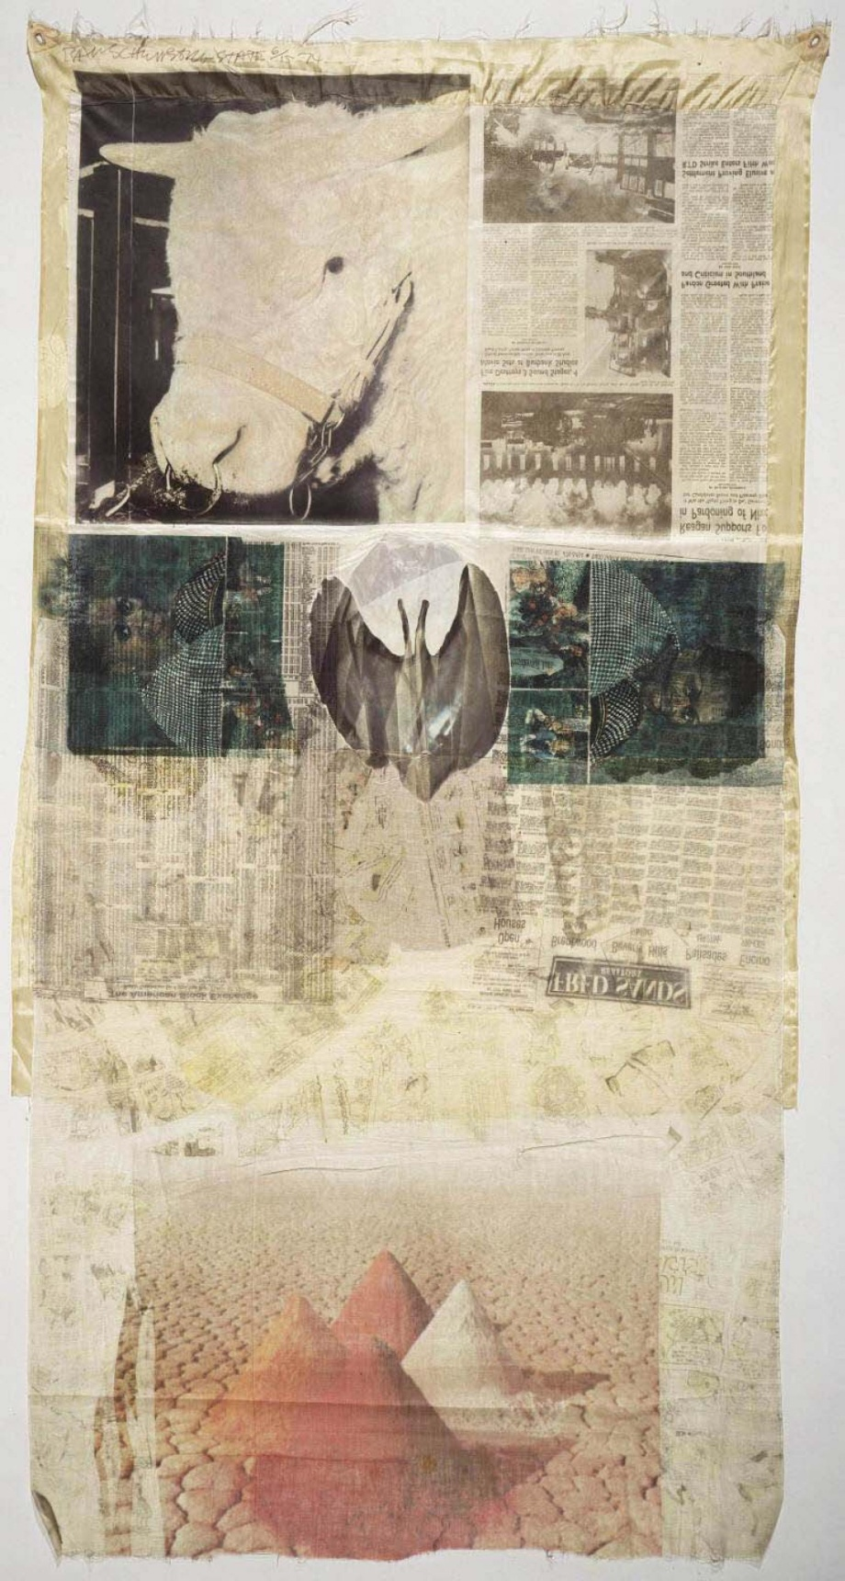
Robert Rauschenberg
Ringer State
(Hoarfrost edition),
1974

Slide 6
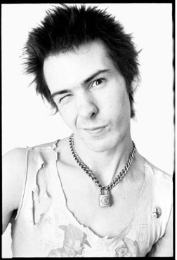
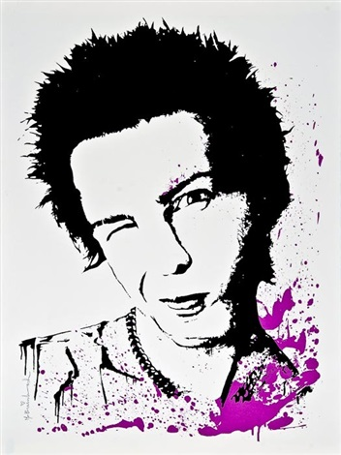
Dennis Morris, Sid Vicious, 1977 (left) and Mr. Brainwash, Sid Vicious (right), derived from the 1977 Dennis Morris photograph

Slide 7
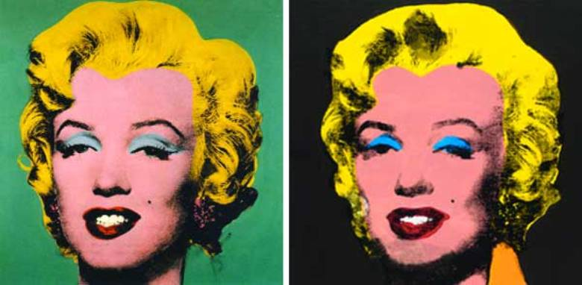
Andy Warhol, Turquoise Marilyn, 1962 (left) and Elaine Sturtevant, Warhol Licorice Marilyn, 2004 (right)

Slide 8
All images in this PowerPoint were taken from the Internet and are used according to the copyright doctrine of fair use.

